Slide 1
Programming 1 - WEEK 5
Tuples
Lists

Slide 2


Slide 3

Recap
Arithmetic
Booleans
Conditionals
None
Strings
Loops

Slide 4

Permanent Evaluation
Be quiet - no talking
Don't cheat, look at your own screen
ONLY allowed to be on ANS
No GenAI – No VSCode – No ppt – No notes – ...
Browser full screen, display light 100%
Scrap paper: strict rules (ask lecturer before test starts)
Duration: 10 minutes
Guess correction: - 1 / (# options – 1)
Close your laptop when finished

Slide 5
Programming 1 - WEEK 5
Tuples
Lists

Slide 6


Collections
Basic building blocks = int, float, bool, string
Glueing them together = collection
Tuples / Named Tuples
Lists
Sets
Dictionaries
…

Slide 7


Tuples
A tuple is an object that can hold an arbitrary number of other objects
( )
name of the tuple
a, b, c, d … are its content
- int
- float
- boolean
- string
- Tuple (or other collections)
or any combination of the above

Slide 8




Tuples - Examples

Slide 9


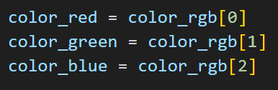
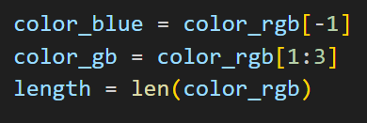
Tuples - Indexing
Each item in a tuple can be referenced with an index:
Destructuring:

Slide 10
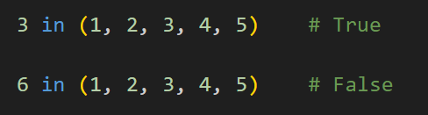
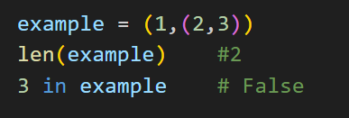
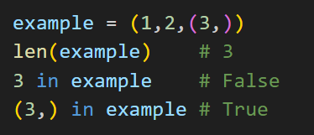
Tuples - Membership

Slide 11
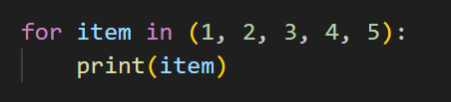
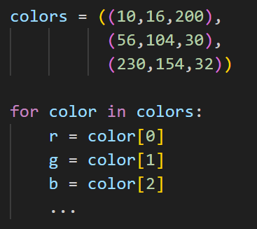
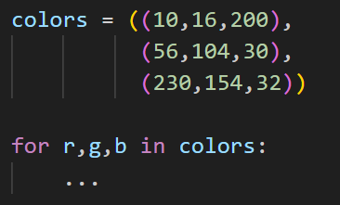
Tuples – Iteration

Slide 12

Tuples - DEMO
An entrance exam consists of a combination of tests, each one being graded on 20. The rules for passing are
It is allowed to skip at most one test.
The average of the tests that were taken must be at least 12.
A skipped test will be represented by the value None.
Write a function entrance_exam(grades) with
grades being a tuple. The function returns a tuple:
( pass , average )
Pass is True if the given grades are good enough
to pass, False otherwise.

Slide 13
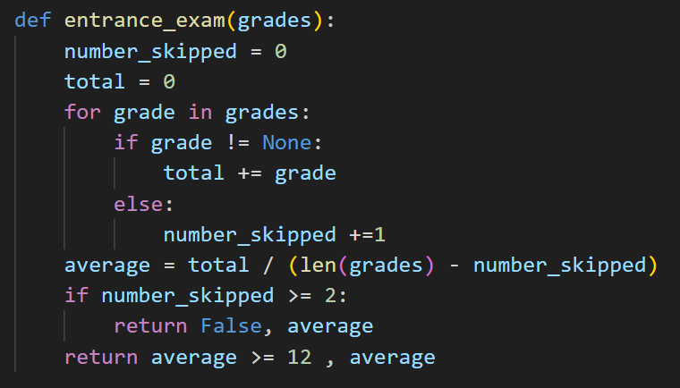
Tuples - DEMO

Slide 14
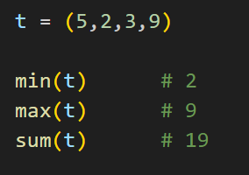

Tuples - Functions
min(t) , max(t) , sum(t)
when you pass a single argument, these
functions expect that argument to be iterable
sorted(t)
returns a sorted list of the elements of t ONLY if the values are comparable!

Slide 15
Programming 1 - WEEK 5
Tuples
Lists

Slide 16
Collections
Basic building blocks = int, float, bool, string
Glueing them together = collection
Tuples
Lists
Sets
Dictionaries
…

Slide 17

Lists
Lists are very much like tuples, except they can be modified
[ ]
name of the list
a, b, c, d … are its content
- int
- float
- boolean
- string
- Tuple or List (or other collections)
or any combination of the above

Slide 18



Lists - Examples

Slide 19
Lists - functionality
All functionality available on tuples also works on lists:
len(), indexing, slicing, sum(), min(), max(),
iteration, destructuring …
(Actually, tuples have a subset of the functionality of lists)
Extra functionality:
updating, adding, removing …

Slide 20
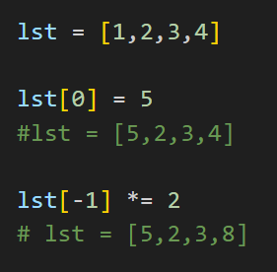
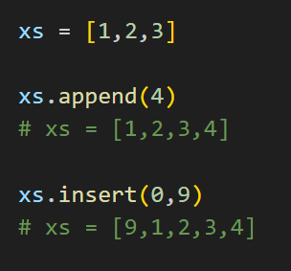
Lists – update & add

Slide 21
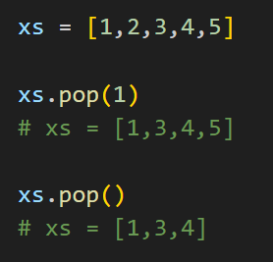
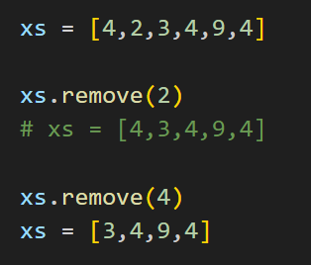
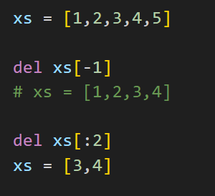
Lists – remove

Slide 22
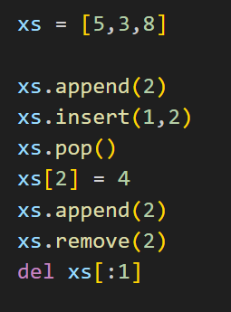

Lists - Example

Slide 23
Lists - DEMO
An entrance exam consists of a combination of tests, each one being graded on 20. The rules for passing are
It is allowed to skip at most one test.
The average of the tests that were taken must be at least 12.
A skipped test will be represented by the value None.
Write a function entrance_exam(grades) with
grades being a list. The function returns a tuple:
( pass , average )
Pass is True if the given grades are good enough
to pass, False otherwise.

Slide 24
Lists - DEMO
Make sure the function entrance_exam(grades) does not only return a tuple with the desired information. It should also clean up the given list: all values that are None should be removed from the list

Slide 25
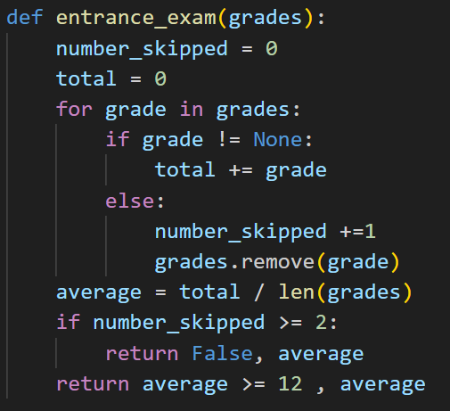
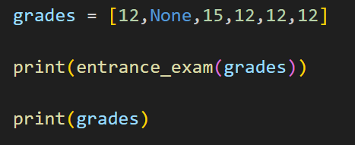
Lists - DEMO

Slide 26
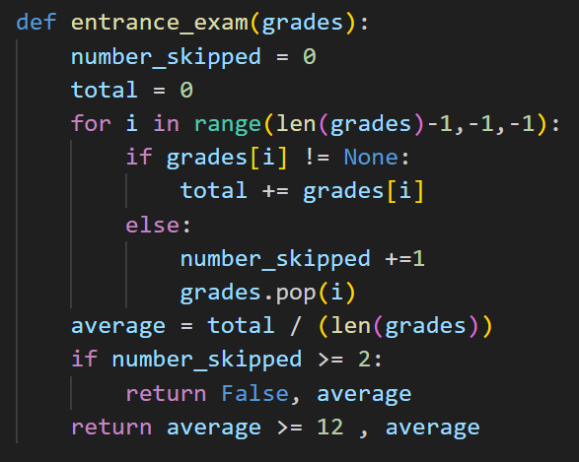
Lists - DEMO

Slide 27


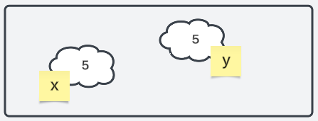
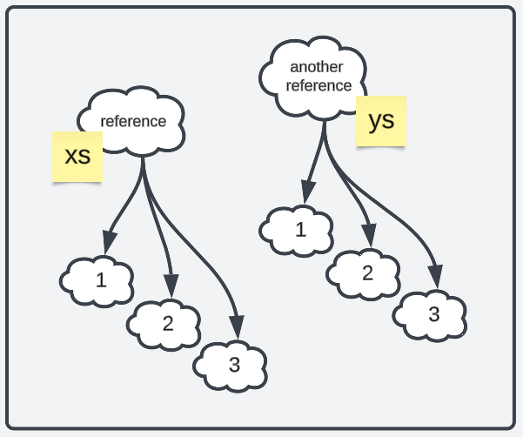
Lists – References

Slide 28


Lists – References

Slide 29


Lists – References

Slide 30
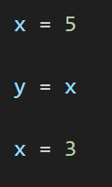
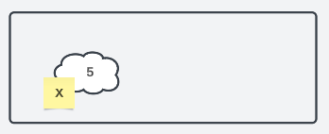
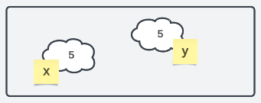
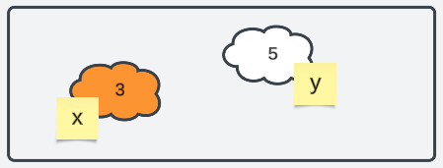



Lists – References

Slide 31
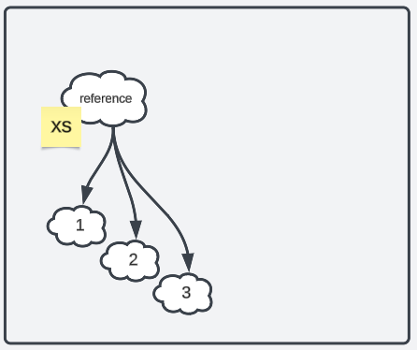
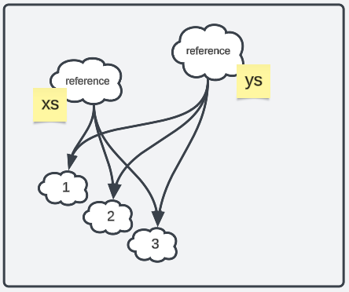
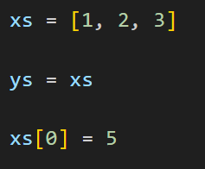
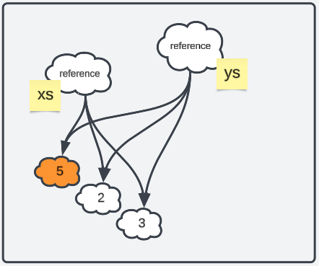

Lists – References

Slide 32
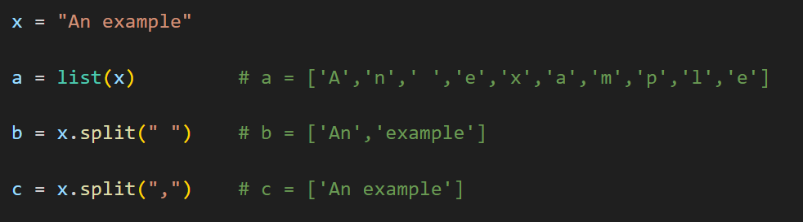
Lists – Usage

Slide 33

Questions?

Slide 34


Toledo – ChatGPT

Slide 35
Lists - DEMO
An entrance exam consists of a combination of tests, each one being graded on 20. The rules for passing are
It is allowed to skip at most one test.
The average of the tests that were taken must be at least 12.
A skipped test will be represented by the value None.
Write a function entrance_exam(grades) with grades being a list. The function returns a tuple: ( pass , average )
Pass is True if the given grades are good enough to pass, False otherwise.
Make sure the function does not only return a tuple with the desired information. It should also clean up the given list: all values that are None should be removed from the list

